Slide 1
Crime Data in Austin, TX
Before, During, and Post Pandemic

Slide 2
What are the top three crimes in Austin, TX from 2019-2021?

Slide 3
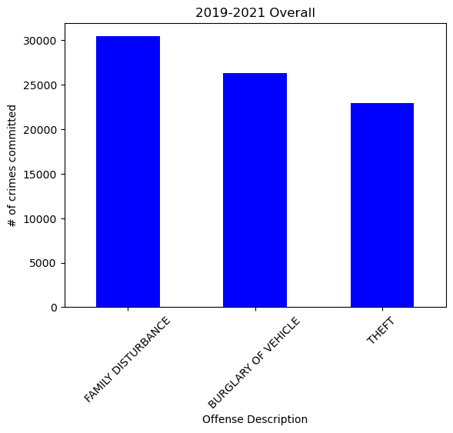
Family Disturbance
Burglary of Vehicle
Theft

Slide 4
What are the similarities between those crimes in 2019-2021?

Slide 5
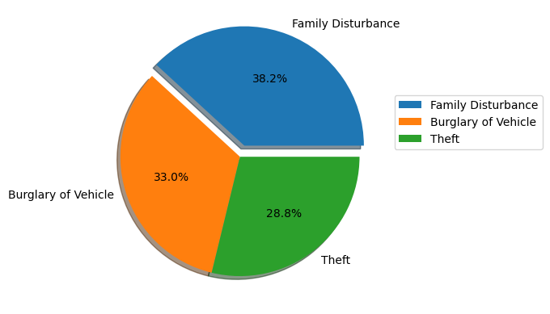
The same three crimes, out of 364, were at the top.
Each individual crime went down in reported cases over the three years.
Crimes reported did not pass the twelve thousand threshold set in 2019.
Family disturbance had the highest percentage of crime committed for all three years.

Slide 6
What are some differences between the crimes from 2019-2021?

Slide 7
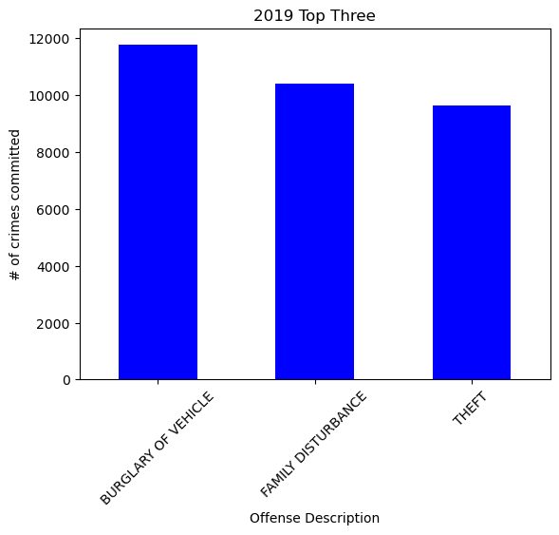
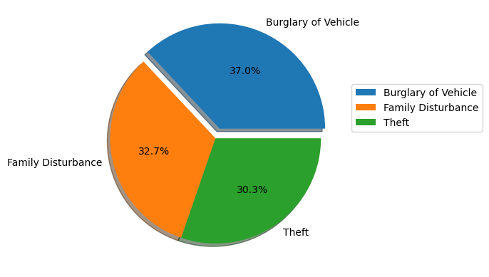
2019

Slide 8
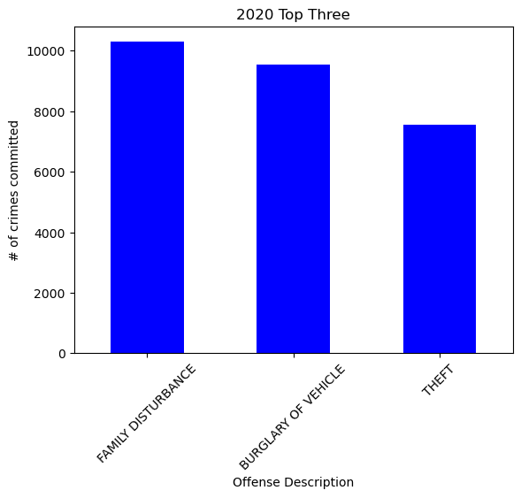
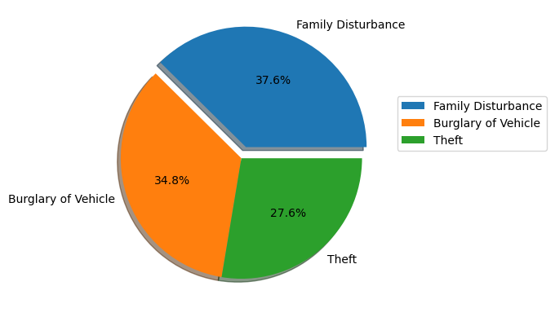
2020

Slide 9
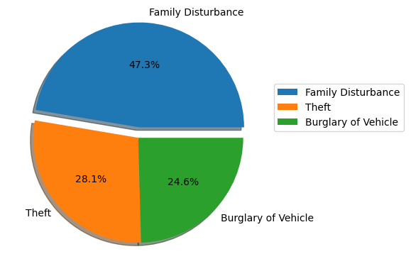
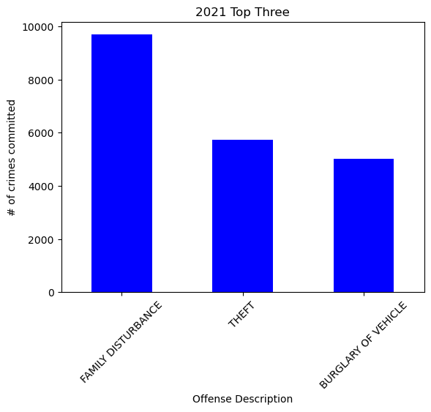
2021

Slide 10
How did the pandemic effect crime in Austin, TX?

Slide 11


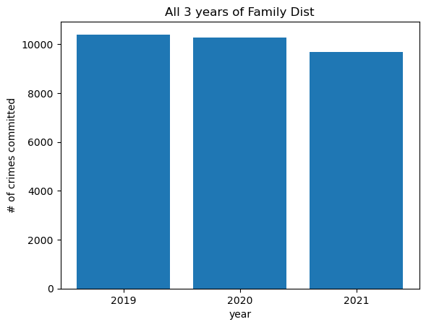

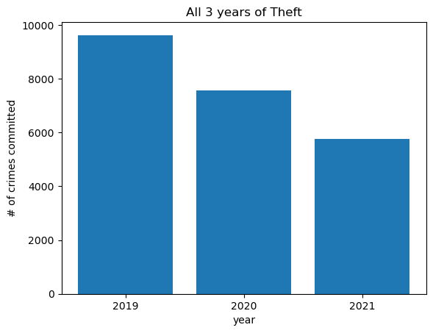
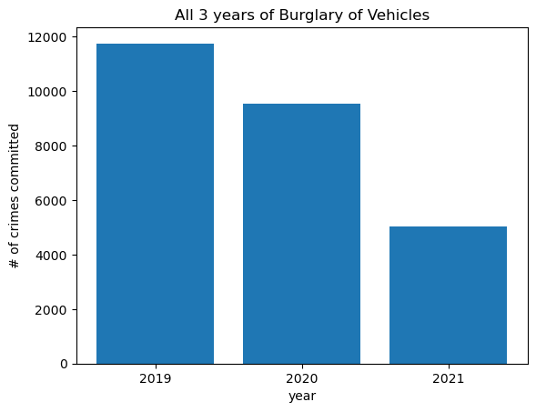
Through the statistics shown, we can see that the top three crimes reported decreased over the course of the pandemic era. From just before the start, during, and after the pandemic in Austin, TX.
The sum of all the statistics for family disturbance, theft, and burglary of vehicle are 79, 627 out of 293, 483 of all crimes committed during that time frame.

